Slide 1
Image Formation and Projection CS B657 Spring 2017

Slide 2
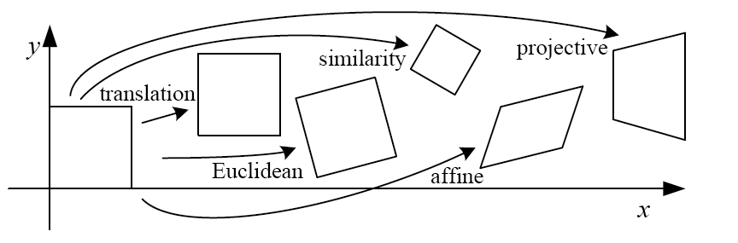
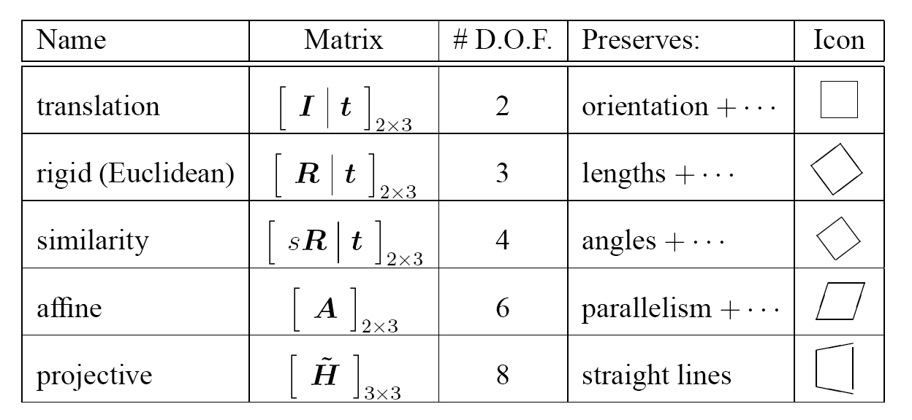
2D image transformations
These transformations are a nested set of groups
Closed under composition and inverse is a member

Slide 3
Image formation
Let’s design a camera
Idea 1: put a piece of film in front of an object
Do we get a reasonable image?
Slide source: Seitz

Slide 4
Pinhole camera
Idea 2: add a barrier to block off most of the rays
This reduces blurring
The opening known as the aperture
Slide source: Seitz
Notes:
Q: How does this transform the image? A: It gets inverted

Slide 5
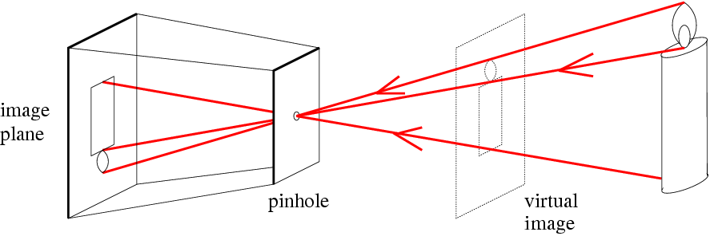
Pinhole camera
f
c
f = focal length
c = center of the camera
Figure from Forsyth

Slide 6
Dimensionality Reduction Machine (3D to 2D)
3D world
2D image
Figures © Stephen E. Palmer, 2002

Slide 7
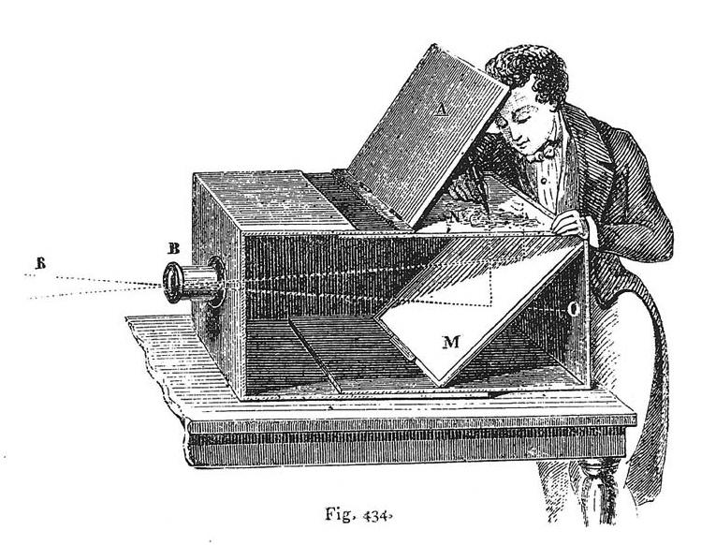
Camera Obscura as a drawing aid
Lens Based Camera Obscura, 1568
Srinivasa Narasimhan’s slide

Slide 8
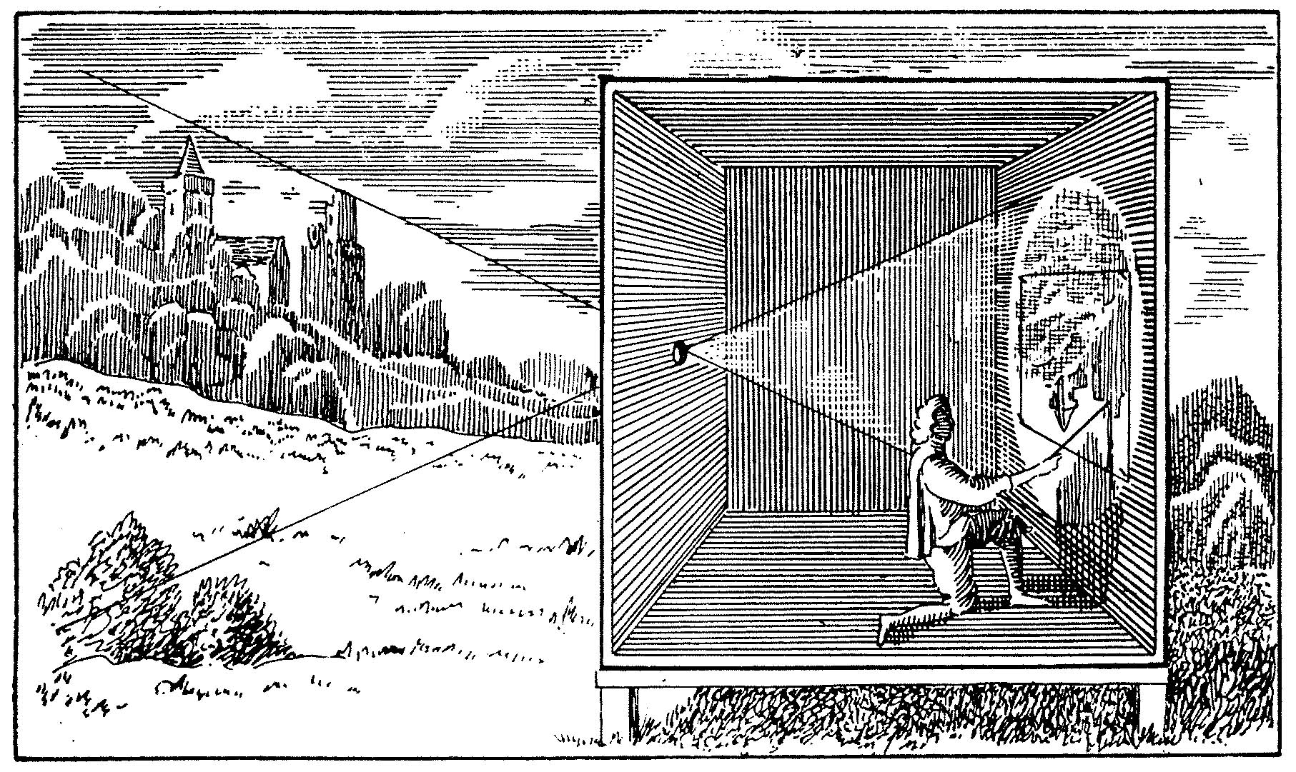

Slide 9
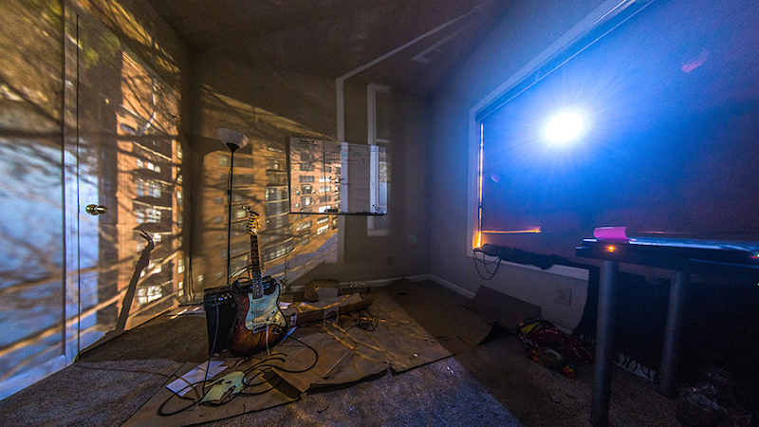
http://petapixel.com/2014/05/12/diy-tutorial-convert-room-camera-obscura/

Slide 10
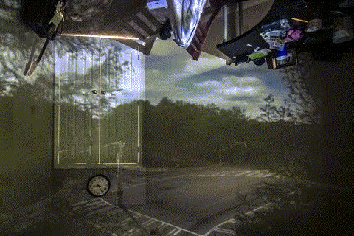
http://petapixel.com/2014/05/12/diy-tutorial-convert-room-camera-obscura/

Slide 11
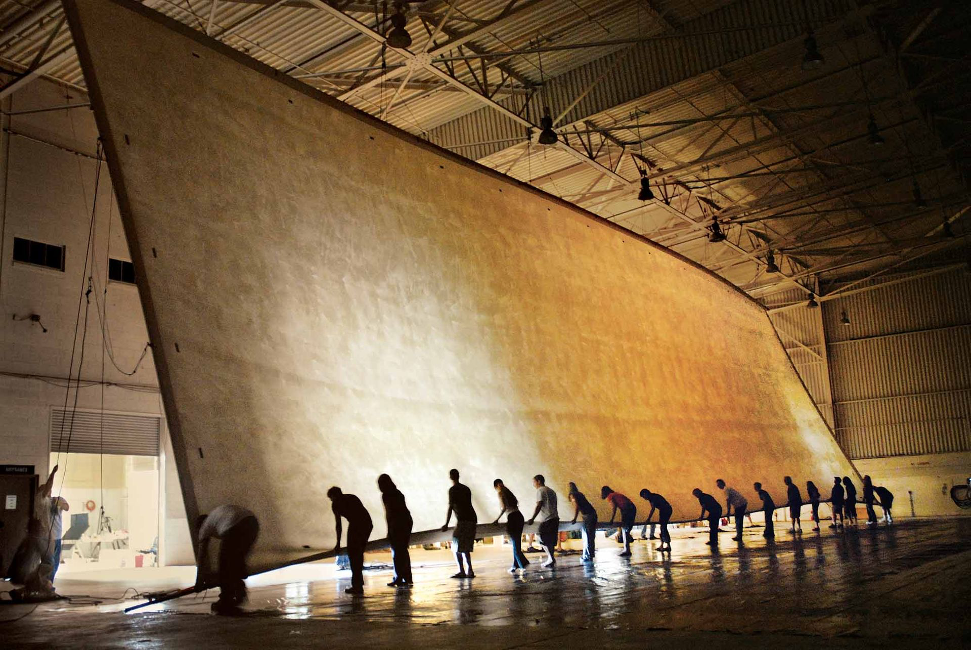
"The Great Picture," 2007

Slide 12
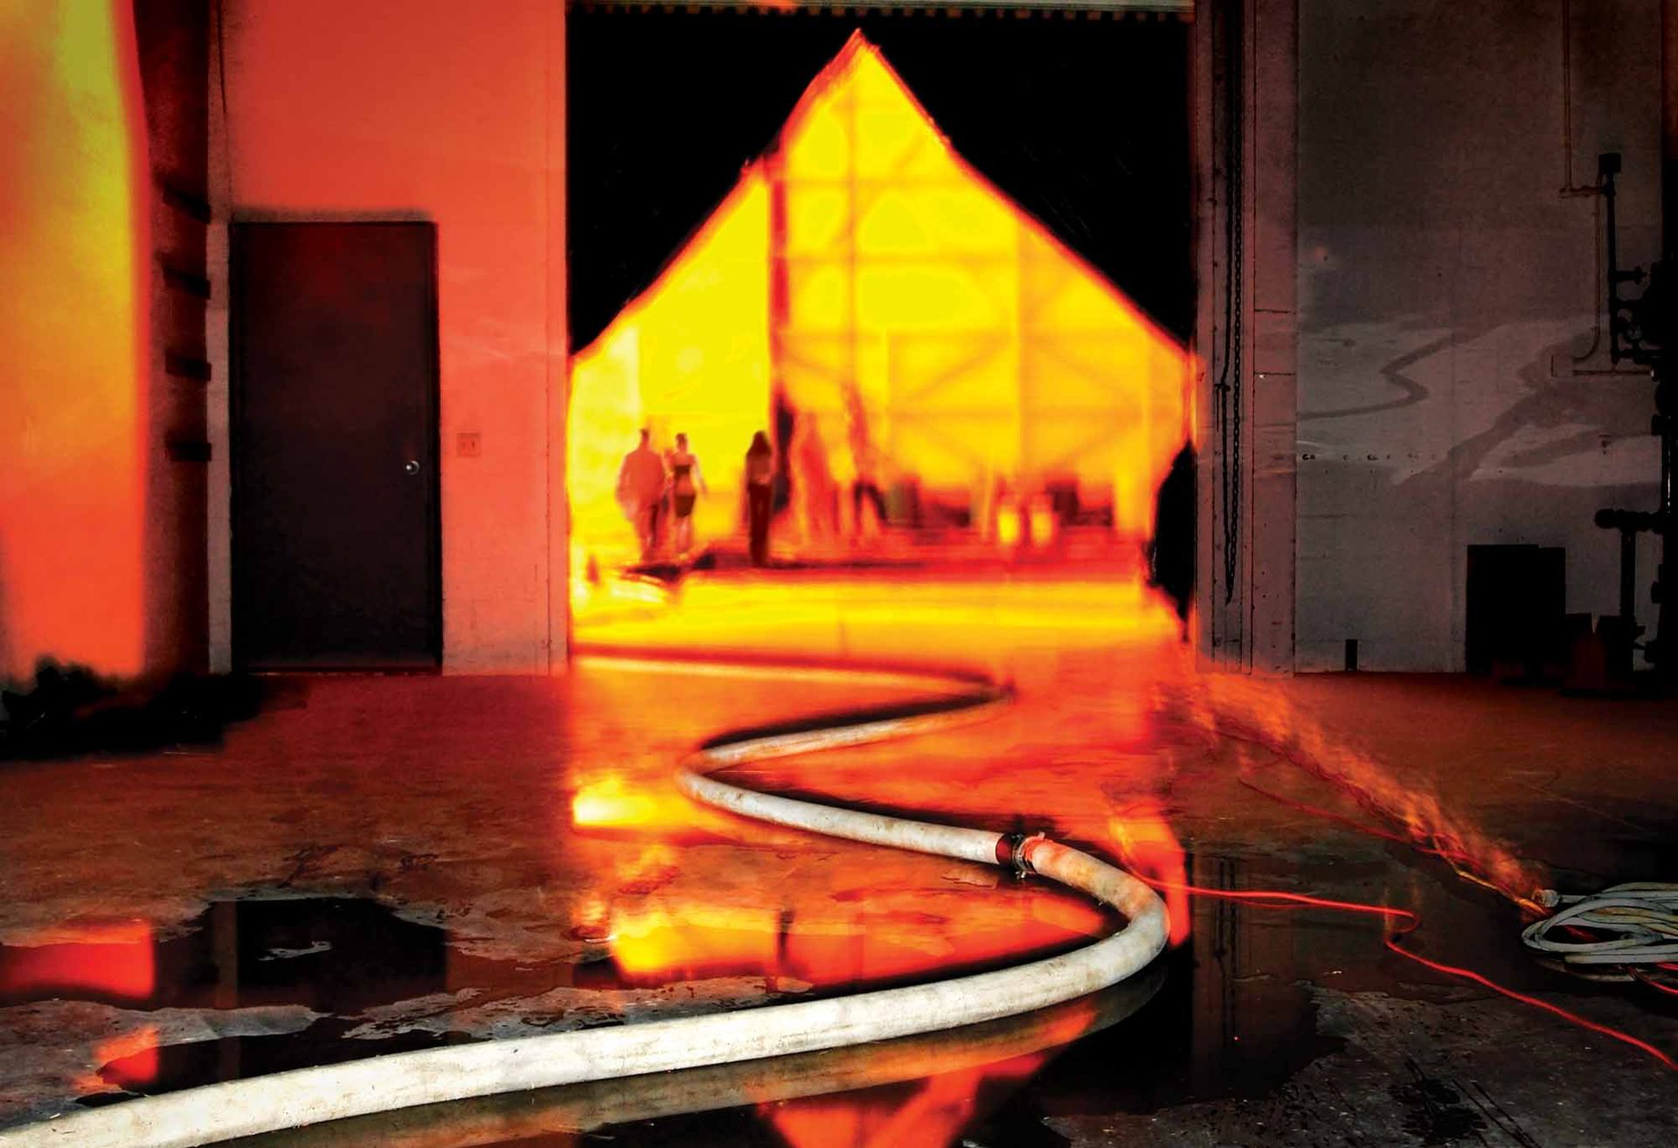
"The Great Picture," 2007

Slide 13
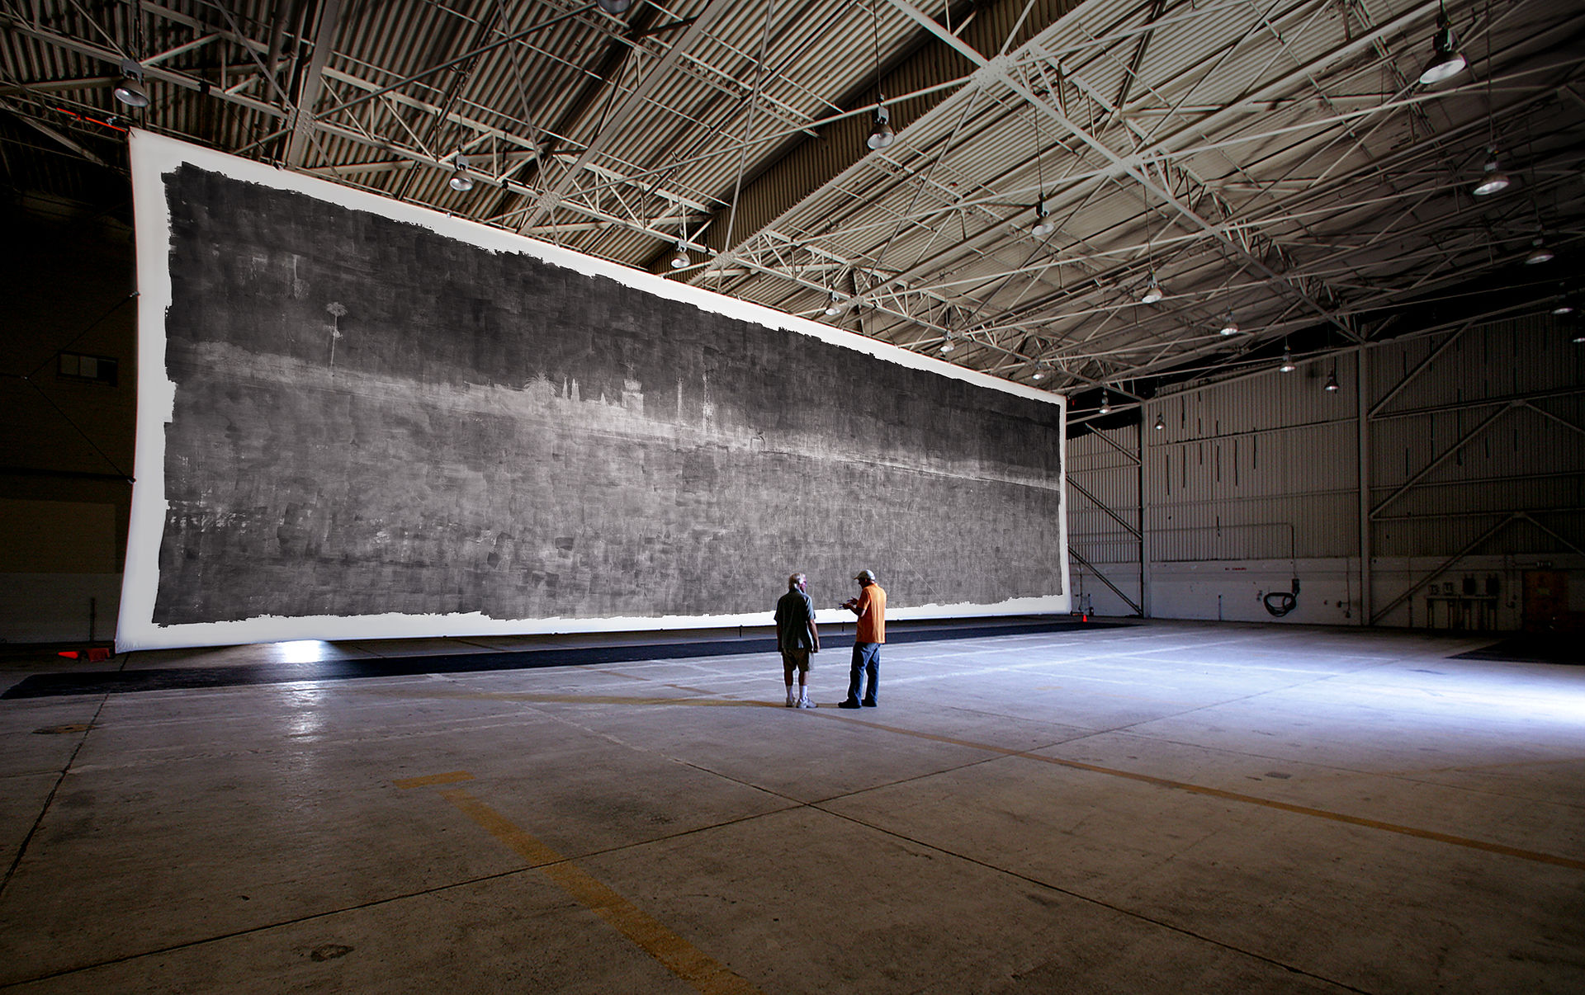
"The Great Picture," 2007

Slide 14
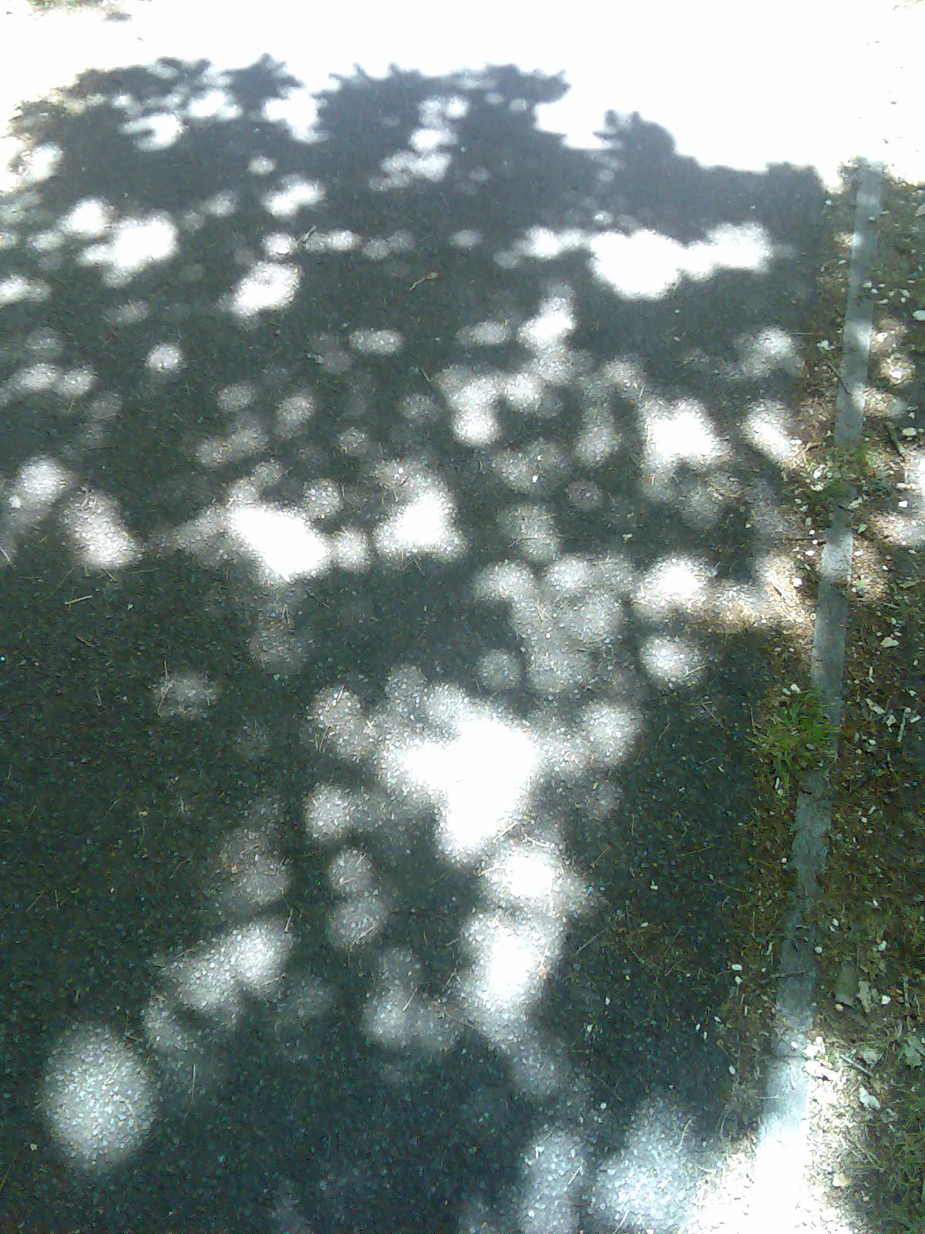
http://myfrencheasel.blogspot.com/2012/05/painting-dappled-light.html

Slide 15
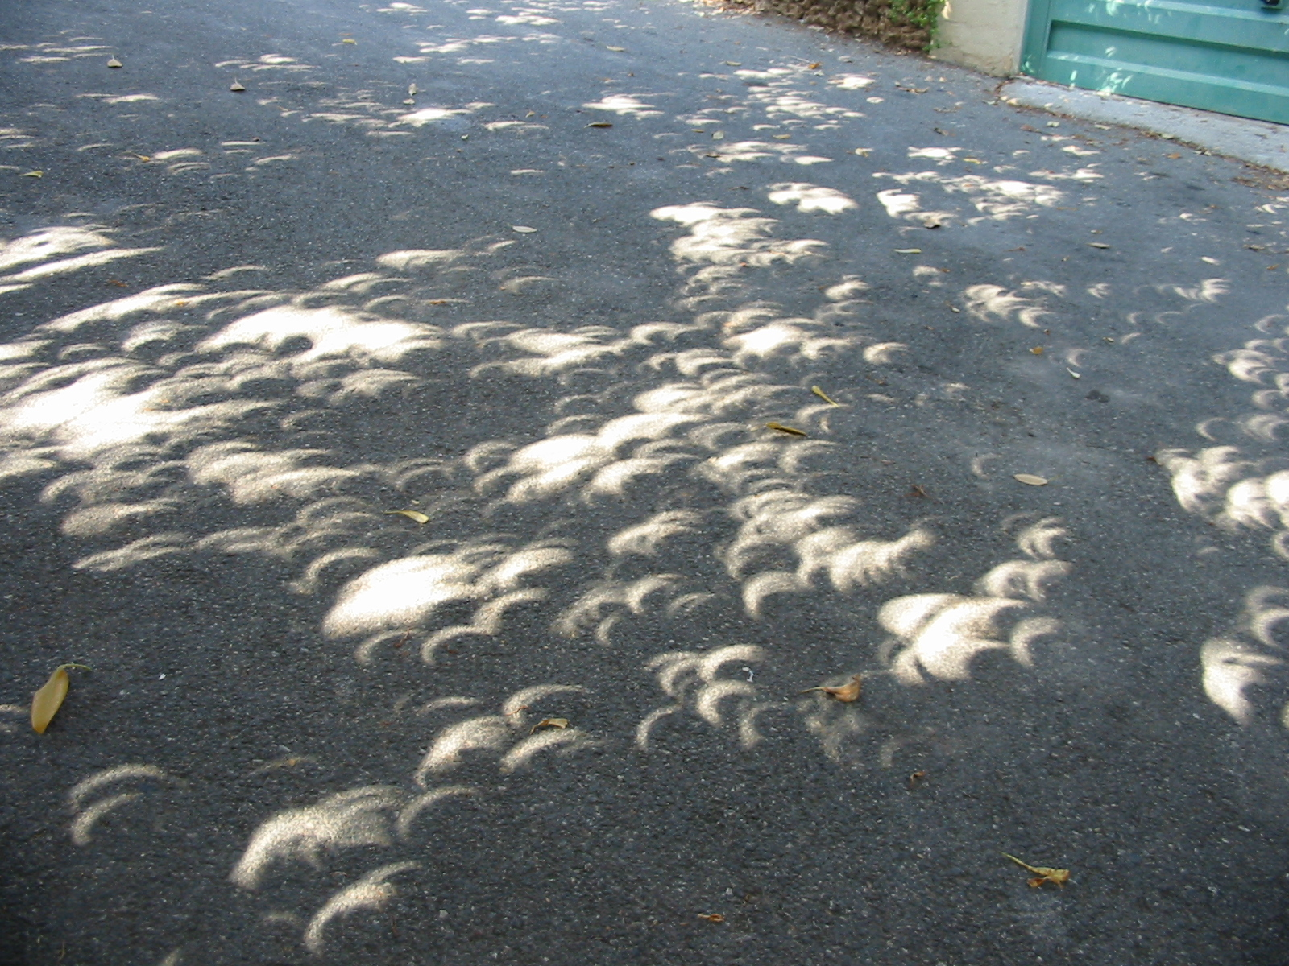
http://myfrencheasel.blogspot.com/2012/05/painting-dappled-light.html

Slide 16
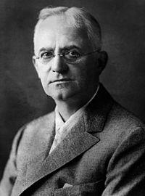
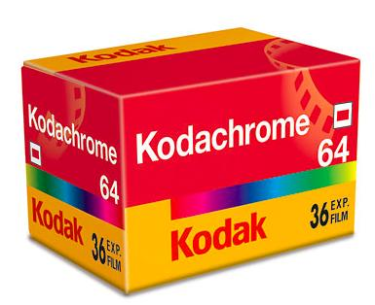
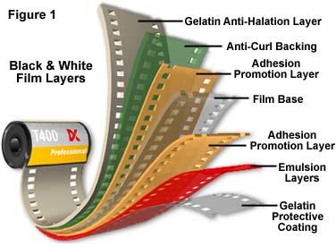
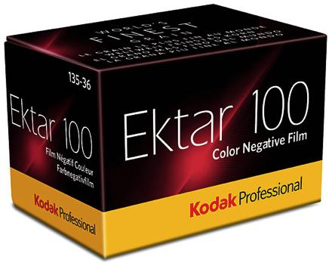
Film photography
Black & white (Eastman, 1885)
Used nitrocellulose until 1930’s
Color film – Kodachrome (1935)

Slide 17
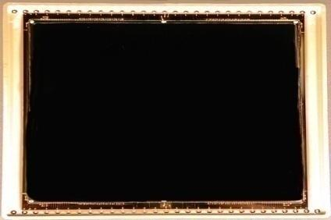
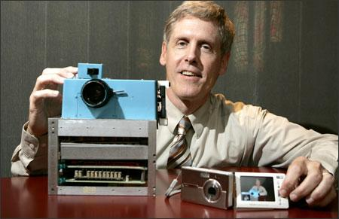
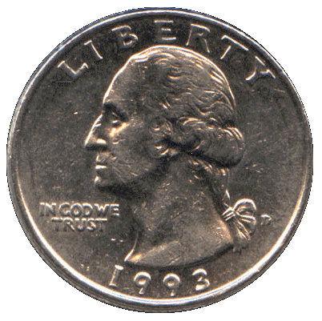
Silicon Image Detector
Silicon Image Detector, 1970
Steve Sasson & first digital camera, 1975

Slide 18
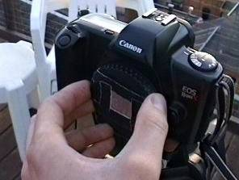
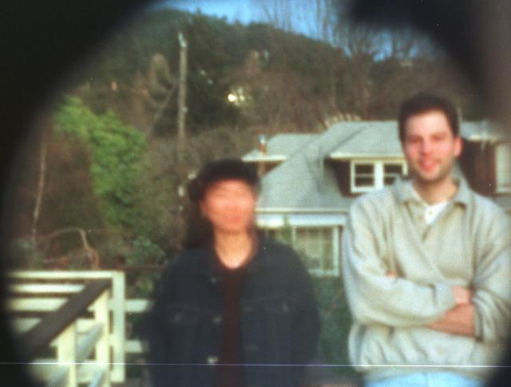
Home-made pinhole camera
Slide by A. Efros
http://www.debevec.org/Pinhole/

Slide 19
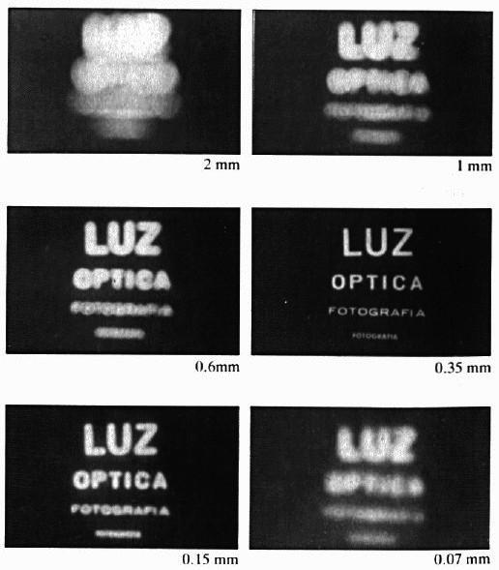
Shrinking the aperture
Why not make the aperture as small as possible?
Less light gets through
Diffraction effects...

Slide 20
Shrinking the aperture

Slide 21
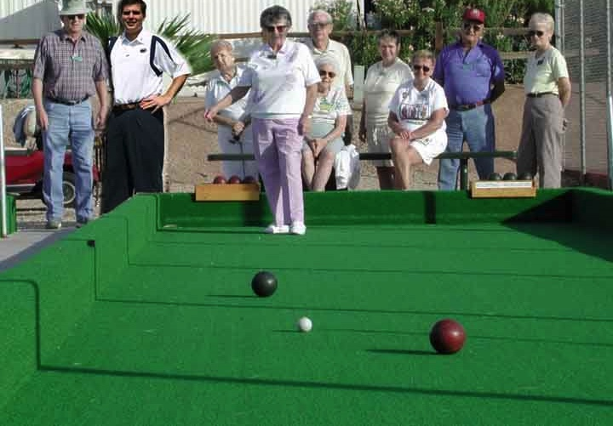
Projective Geometry
What is lost?
Length
Who is taller?
Which is closer?

Slide 22
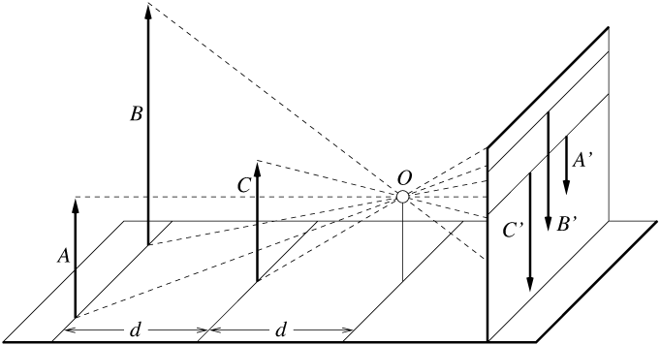
Length is not preserved
A’
C’
B’
Figure by David Forsyth

Slide 23
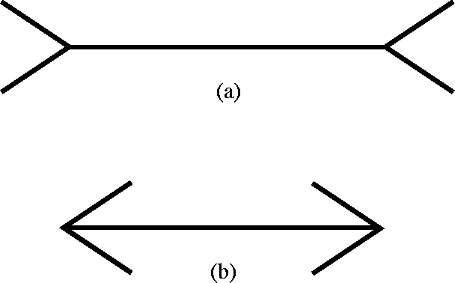
Müller-Lyer Illusion

Slide 24
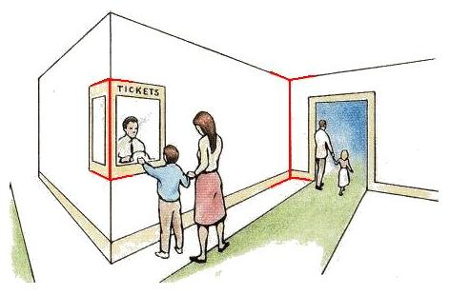
Müller-Lyer Illusion
http://www.michaelbach.de/ot/sze_muelue/index.html

Slide 25
Projective Geometry
What is lost?
Length
Angles
Parallel?
Perpendicular?

Slide 26
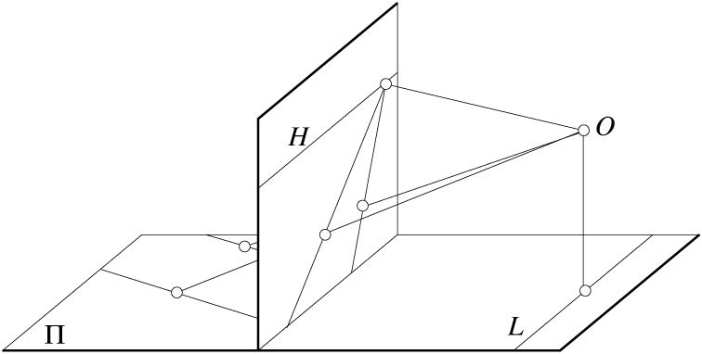
Parallel lines are not parallel in the image
Figure by David Forsyth

Slide 27
Projective Geometry
What is preserved?
Straight lines are still straight

Slide 28
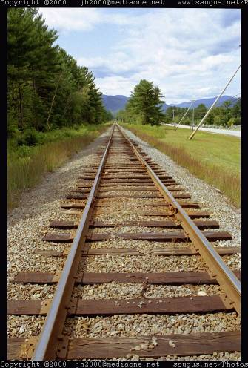
Vanishing points and lines
Parallel lines in the world intersect in the image at a “vanishing point”
Notes:
Go to board, sketch out various properties of vanishing points/lines

Slide 29
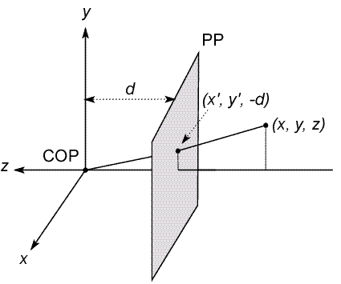
Modeling projection
The coordinate system
Pinhole (aka Center Of Projection) at the origin
Image plane (Projection Plane) in front of the COP
The camera looks down the negative z axis
Notes:
This way the image is right-side-up

Slide 30
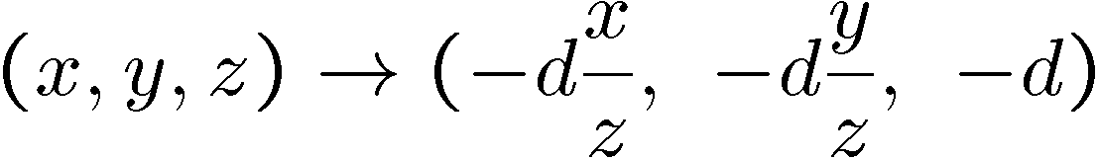
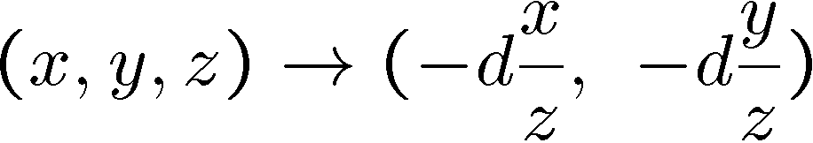
Modeling projection
Projection equations
Compute intersection with PP of ray from (x,y,z) to COP
Throw out the last coordinate to get projection:

Slide 31
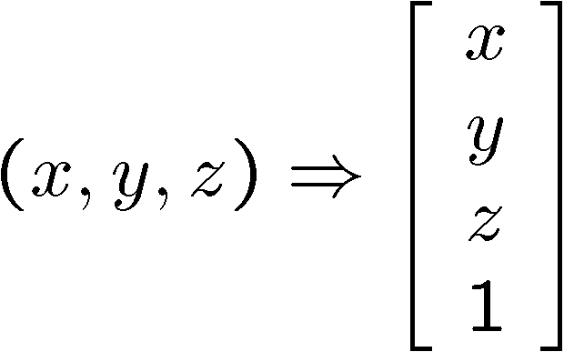
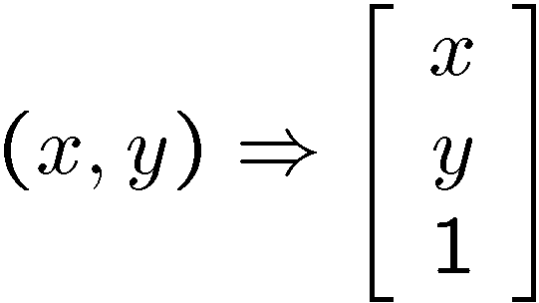
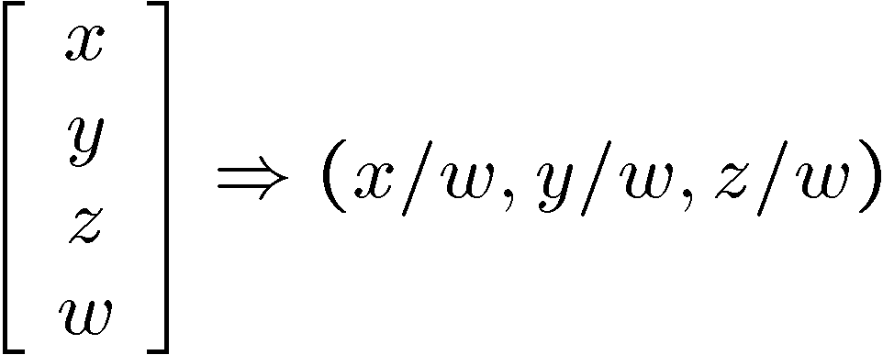
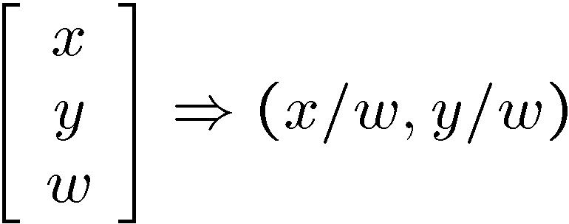
Transformation
Is this a linear transformation?
no—division by z is nonlinear
Trick: add one more coordinate:
homogeneous image
coordinates
homogeneous scene
coordinates
Converting from homogeneous coordinates

Slide 32
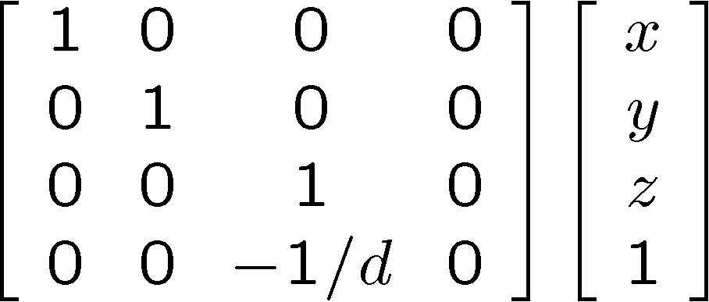
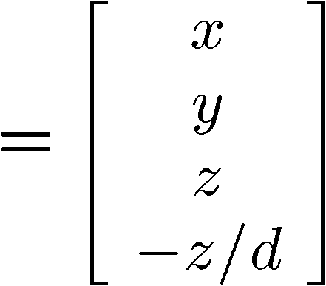
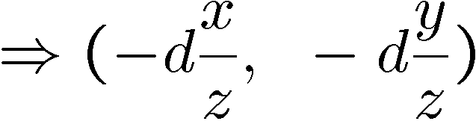
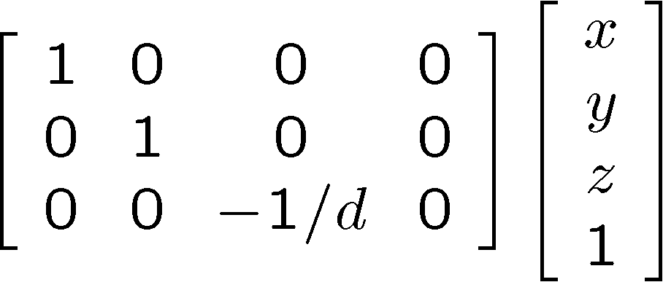
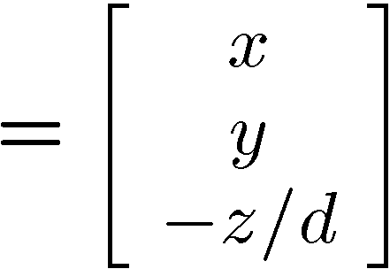
Perspective Projection
Projection is a linear transformation using homogeneous coordinates:
Discard third coordinate,
divide by fourth coordinate
This is known as perspective projection
The matrix is the projection matrix
Alternatively, use 3x4 matrix (which discards 3rd coordinate)
divide by third coordinate

Slide 33
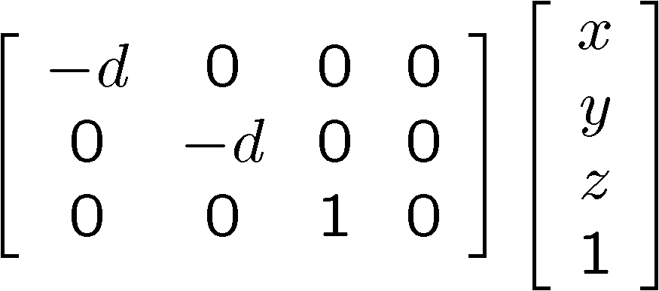
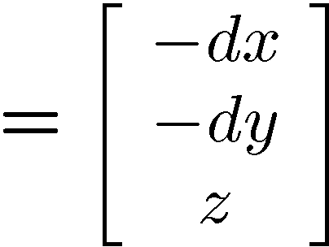
Perspective Projection
How does scaling the projection matrix change the transformation?

Slide 34
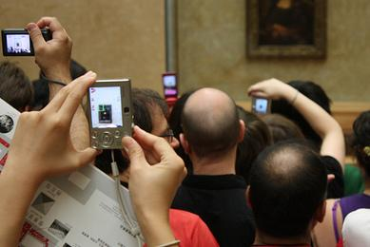
Projection matrix
Diagonal projection matrices only apply in the simplest of cases
Image plane is exactly perpendicular to scene, camera orientation is exactly upright, etc.
In general, projection matrix is a full projective transformation matrix

Slide 35
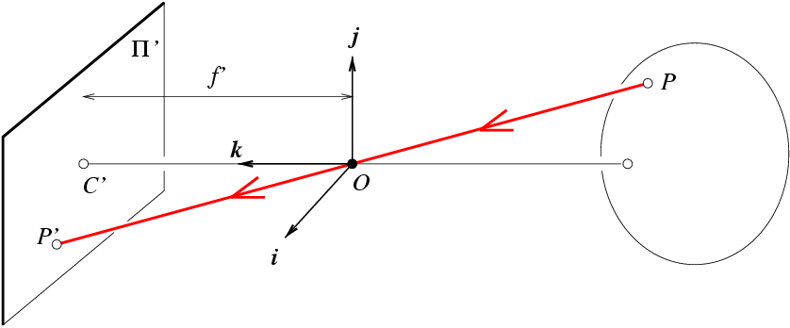
Projection matrix
Intrinsic Assumptions
Unit aspect ratio
Principal point at (0,0)
No skew
Extrinsic Assumptions
No rotation
Camera at (0,0,0)
K
Slide Credit: Saverese
Notes:
Work through equations for u and v on board

Slide 36
Remove assumption: known optical center
Intrinsic Assumptions
Unit aspect ratio
No skew
Extrinsic Assumptions
No rotation
Camera at (0,0,0)

Slide 37
Remove assumption: square pixels
Intrinsic Assumptions
No skew
Extrinsic Assumptions
No rotation
Camera at (0,0,0)

Slide 38
Remove assumption: non-skewed pixels
Intrinsic Assumptions
Extrinsic Assumptions
No rotation
Camera at (0,0,0)
Note: different books use different notation for parameters

Slide 39
Oriented and Translated Camera
R
j_{w}
t
k_{w}
O_{w}
i_{w}

Slide 40
Allow camera translation
Intrinsic Assumptions
Extrinsic Assumptions
No rotation

Slide 41
3D Rotation of Points
Slide Credit: Saverese
Rotation around the coordinate axes, counter-clockwise:
p’
γ
y
p
z

Slide 42
Allow camera rotation

Slide 43
Degrees of freedom
5
6
Notes:
How many known points are needed to estimate this?

